Slide 1


Robotic Arm Project
Open Meeting – 10/9/25

Slide 2
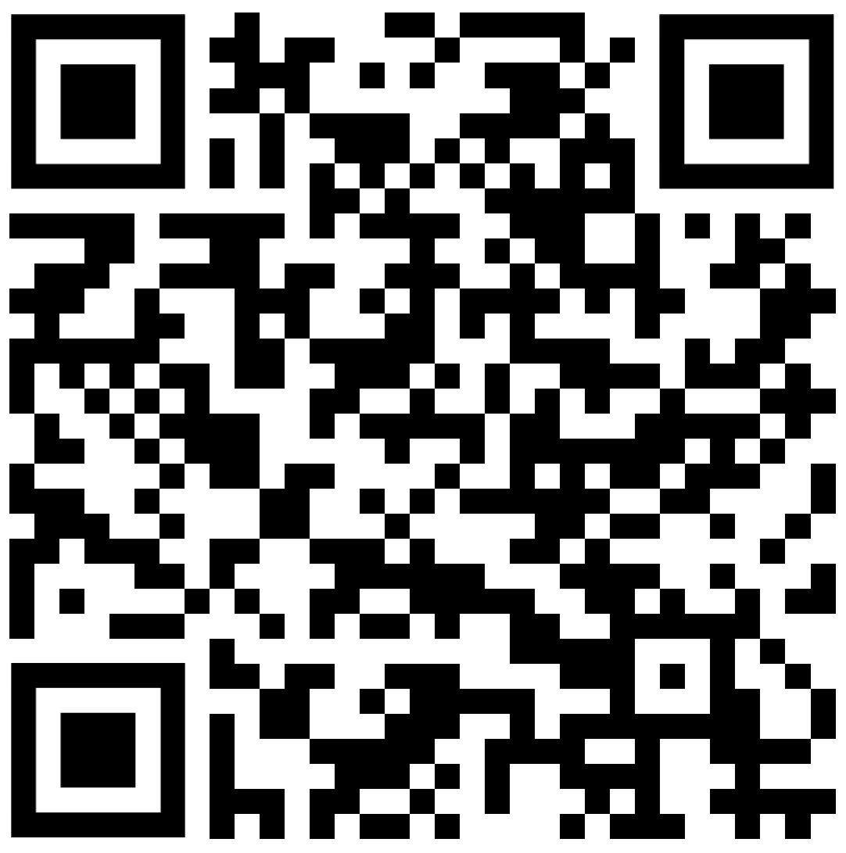
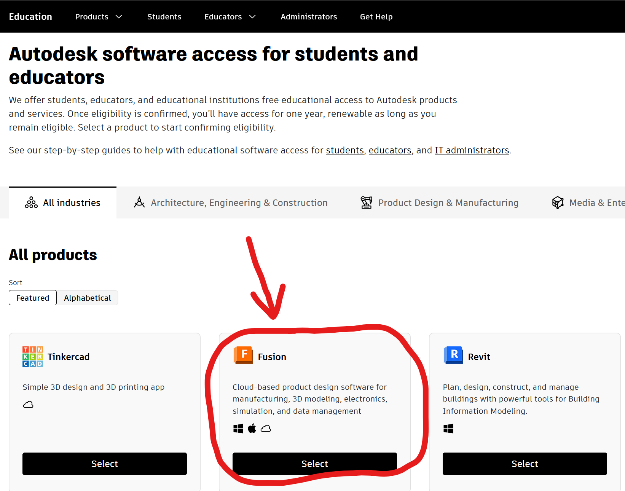

Robotic Arm Project Meeting
Setting up Fusion Education
https://www.autodesk.com/education/edu-software
© Robotics@UH 2025

Slide 3

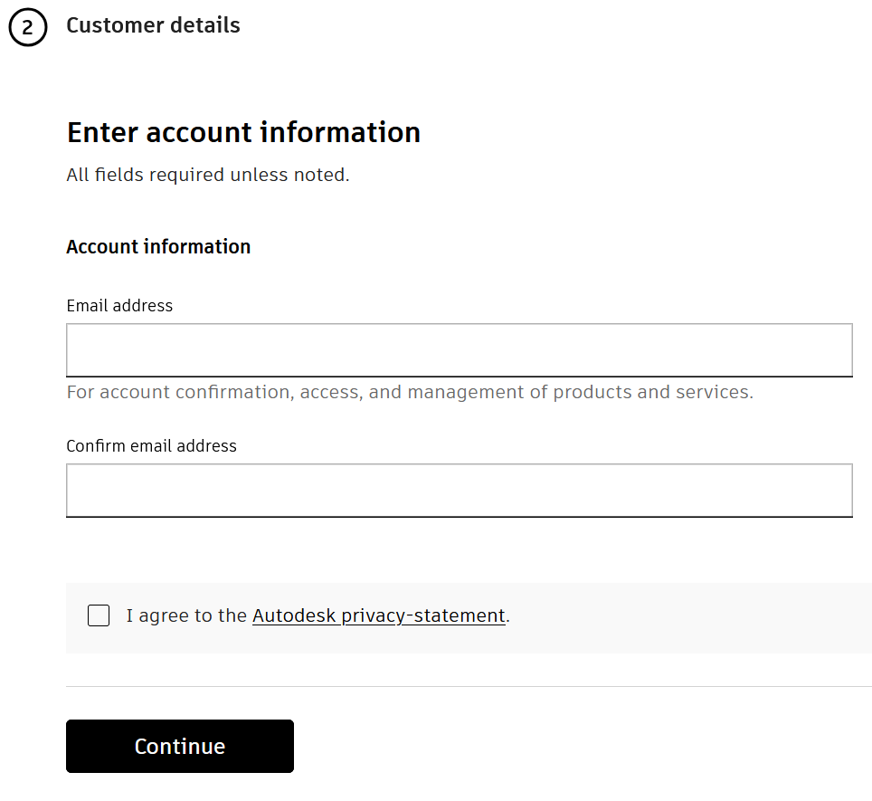
Robotic Arm Project Meeting
Setting up Fusion Education
© Robotics@UH 2025

Slide 4


Robotic Arm Project Meeting
Setting up Fusion Education
Once you’ve reached the questions about the Educational Institution, input the information about the university and your graduation time.
University Address
Ensure you select the University of Houston, not UH Downtown, UH Clear Lake, etc.
© Robotics@UH 2025

Slide 5
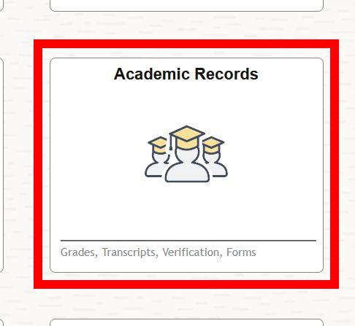
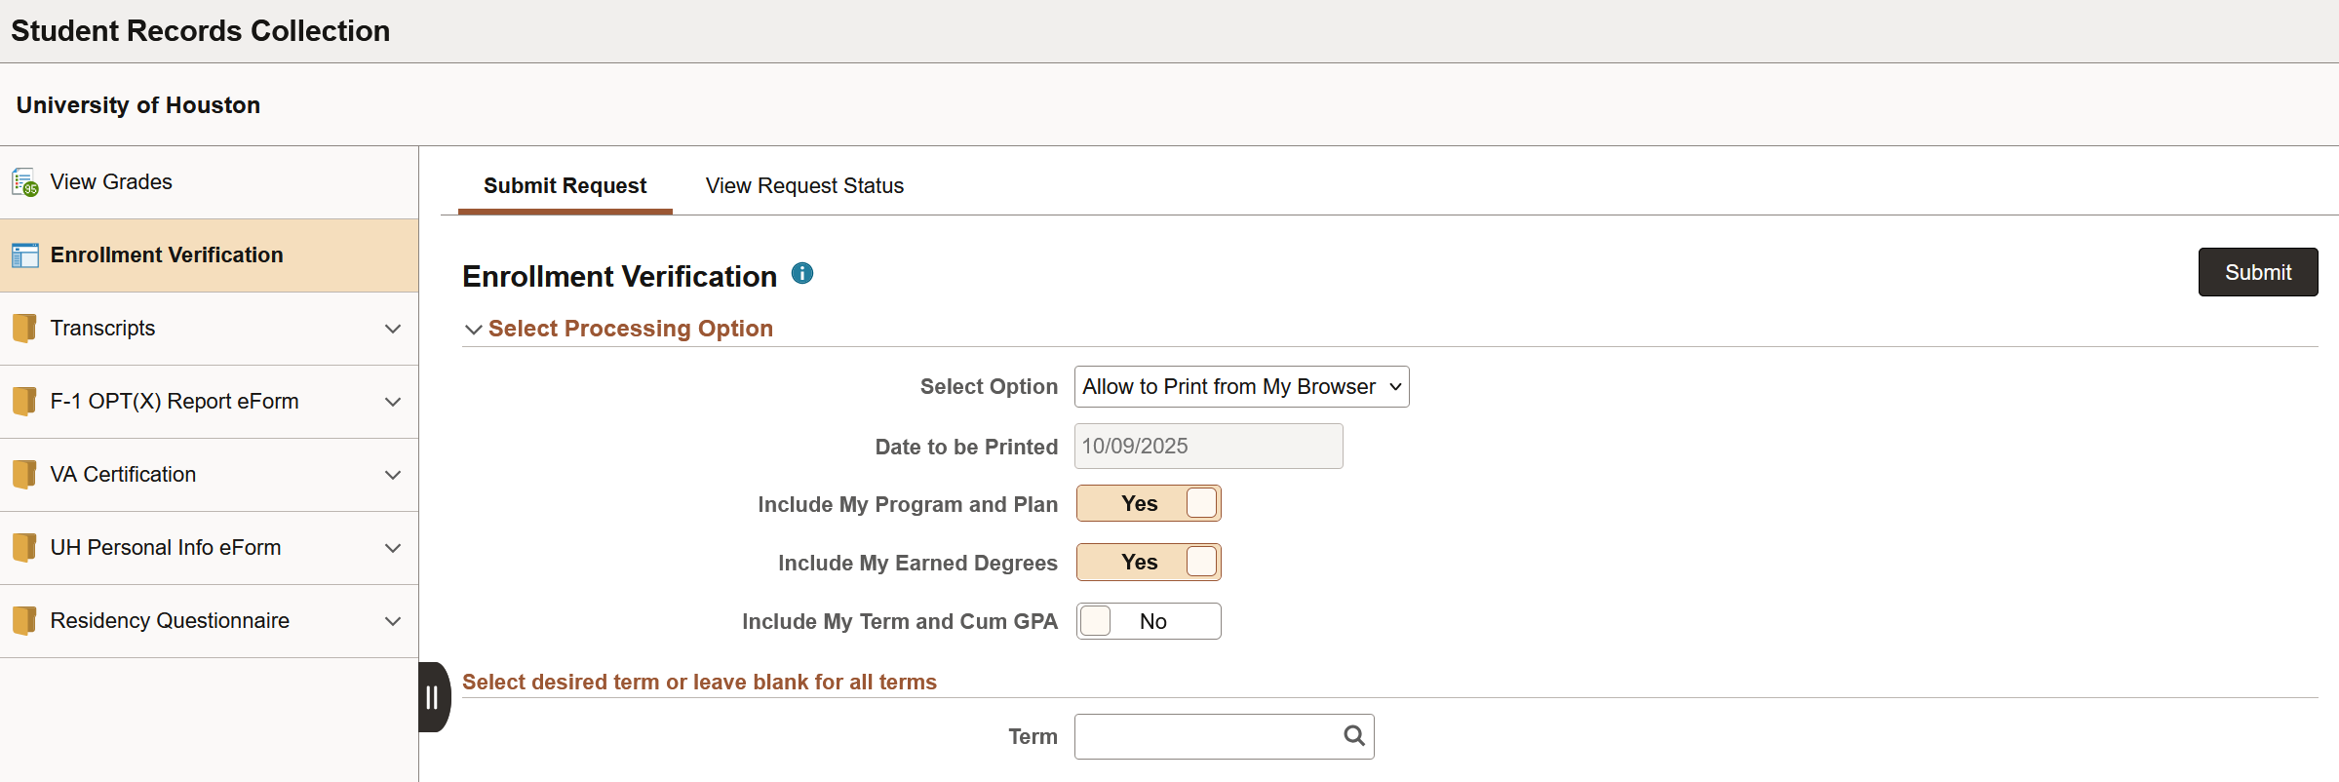
Robotic Arm Project Meeting
Setting up Fusion Education
© Robotics@UH 2025

Slide 6
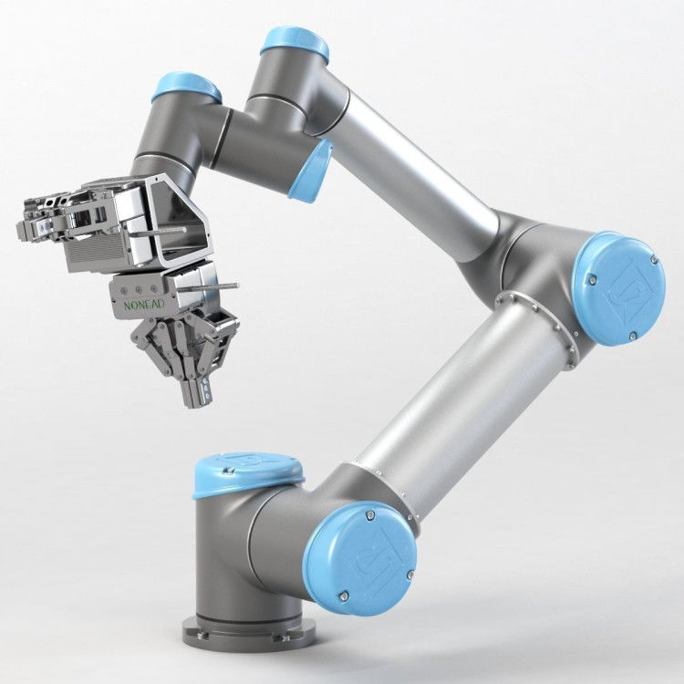
Robotic Arm Project Meeting
Our Inspiration: Universal Robotics UR5e
The UR5e is a 6-degree-of-freedom (6 DoF) mass-market robotic arm developed by Universal Robotics. It’s a collaborative robot (cobot), meaning it’s rated to work in the vicinity of humans without posing a safety risk.
With a payload capacity of 5kg and a total weight of just 20.6 kg it’s undoubtedly a feat of countless hours of engineering.
So as a group of overambitious college students, we’re going to try and match that, and for cheaper!
© Robotics@UH 2025

Slide 7

Robotic Arm Project Meeting
The Goals
-Achieve a 3 - 5kg payload capacity.
-Maintain a total project cost under approx. $38k. (lol)
-Keep system power consumption low (UR5e draws only 200 watts).
-Reduce system weight and footprint as much as realistically possible.
© Robotics@UH 2025

Slide 8

The Goals: Are they realistic?
Robotic Arm Project Meeting
The UR5e is the result of years of R&D by Universal Robotics. Its motors are proprietary, and information is not available to the public.
In addition, its material selection and structure have been meticulously designed for the greatest performance.
In short: mehhhhhhhh
We’re going to try anyway.
© Robotics@UH 2025

Slide 9
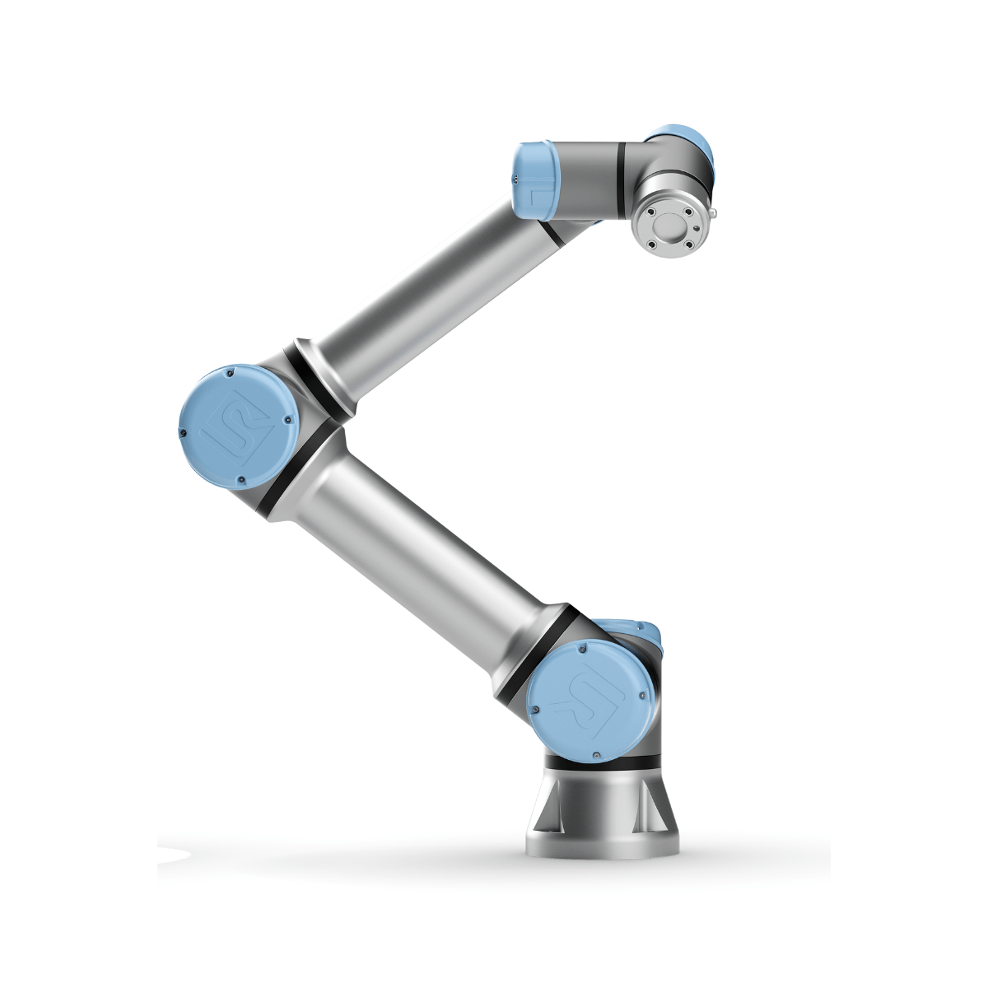
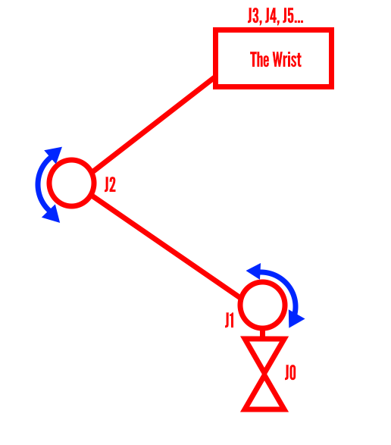
Robotic Arm Project Meeting
UR5e: Design Overview
© Robotics@UH 2025

Slide 10
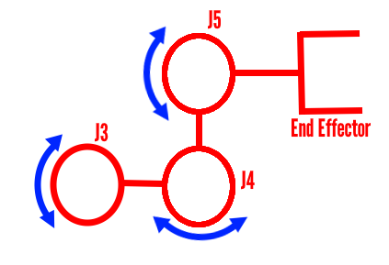
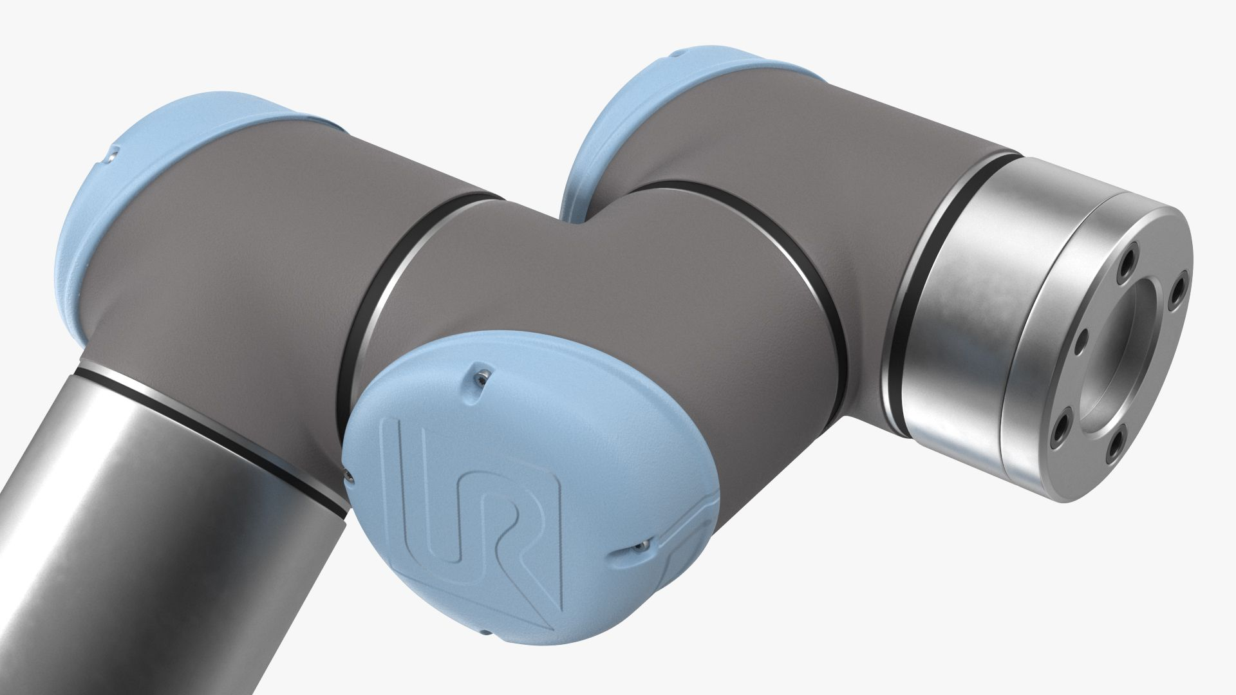
Robotic Arm Project Meeting
UR5e: Design Overview
© Robotics@UH 2025

Slide 11
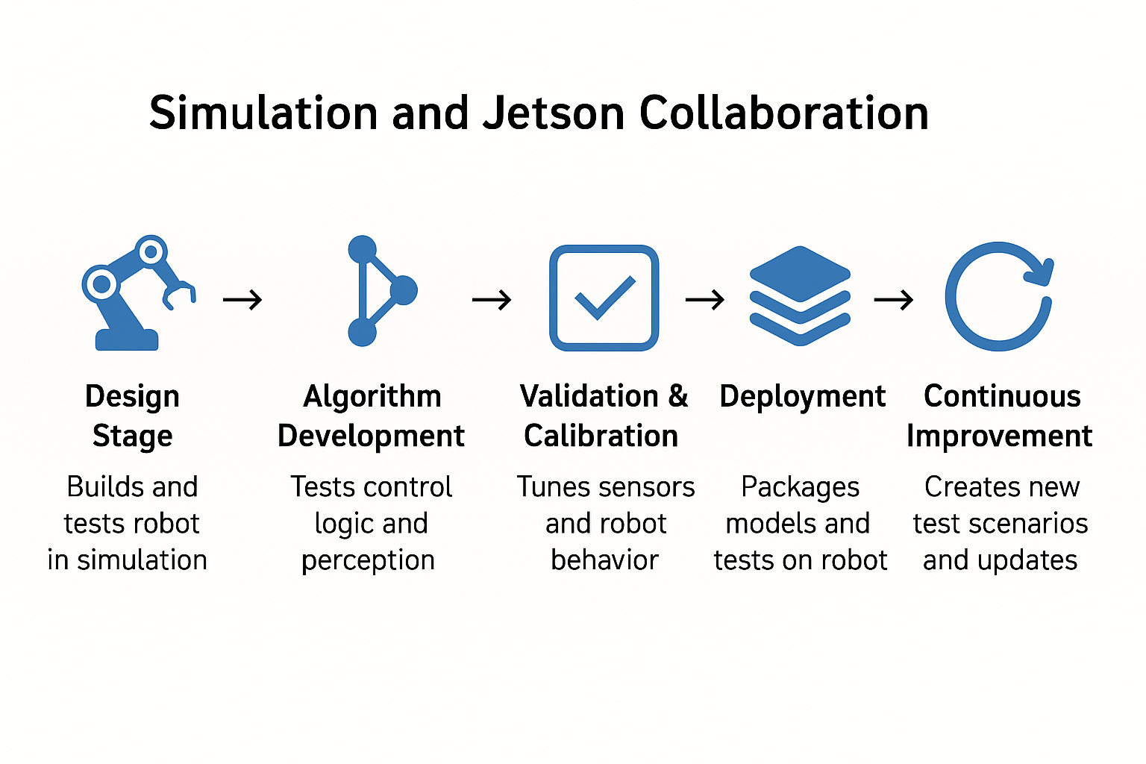
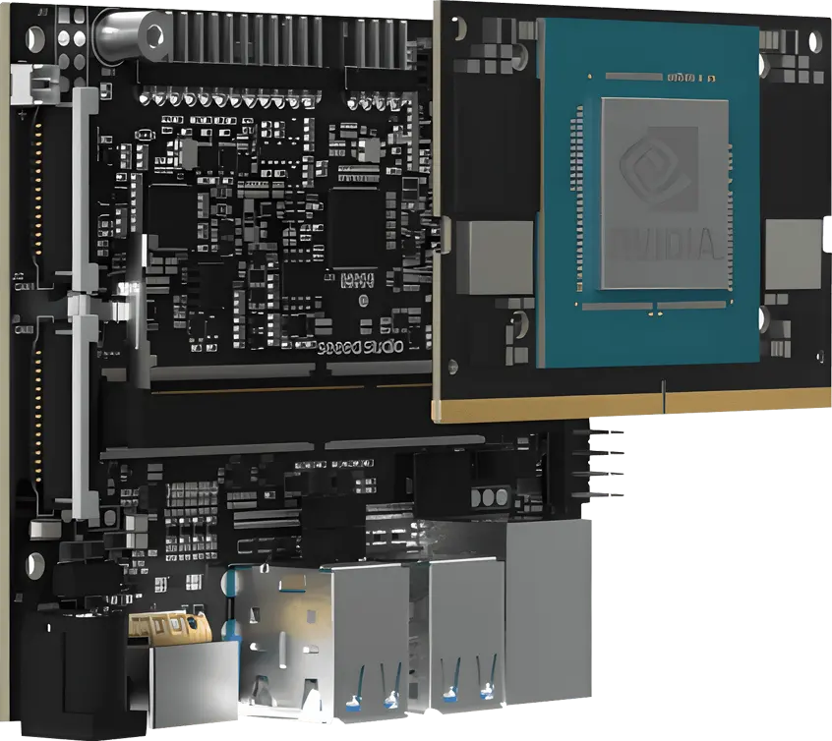
Robotic Arm Project Meeting
“Simulation builds it. Jetson runs it. Simulation tests ideas safely; Jetson proves them in the real world. The tighter we sync the two, the faster we move from virtual to real success.”
© Robotics@UH 2025

